Slide 1
NLP Surname Classification with CNN lecture 03.5
Branko Žitko

Slide 2
Contents
Vocabulary, Vectorizer
Dataset
DataLoader
A Convolutional Neural Network
The Training Routine
Evaluation, Inference, Inspection
Regularizing MLPs

Slide 3
Vocabulary
Vocabulary maps token to index and vice versa
It can also use fixed index for unknown tokens.
SurnameVocab
NationalityVocab
Rahal →
idx | token
-1 | <unk>
0 | Jackson
1 | Rahal
2 | Panek
…
n
→ 1
idx | token
0 | 1
1 | 2
…
m
2 →
→ Panek

Slide 4
Vocabulary
Vocabulary
class Vocabulary(object): def __init__(self, token_to_idx=None, add_unk=True, unk_token="<UNK>"): if token_to_idx is None: token_to_idx = {} self._token_to_idx = token_to_idx self._idx_to_token = {idx: token for token, idx in self._token_to_idx.items()} self._add_unk = add_unk self._unk_token = unk_token self.unk_index = -1 if add_unk: self.unk_index = self.add_token(unk_token) def add_token(self, token): if token in self._token_to_idx: index = self._token_to_idx[token] else: index = len(self._token_to_idx) self._token_to_idx[token] = index self._idx_to_token[index] = token return index def add_many(self, tokens): return [self.add_token(token) for token in tokens]

Slide 5
Vocabulary
…
def lookup_token(self, token): if self.unk_index >= 0: return self._token_to_idx.get(token, self.unk_index) else: return self._token_to_idx[token] def lookup_index(self, index): if index not in self._idx_to_token: raise KeyError("the index (%d) is not in the Vocabulary" % index) return self._idx_to_token[index] def to_serializable(self): return {'token_to_idx': self._token_to_idx, 'add_unk': self._add_unk, 'unk_token': self._unk_token} @classmethod def from_serializable(cls, contents): return cls(**contents) def __str__(self): return f"<Vocabulary(size={len(self)})>" def __len__(self): return len(self._token_to_idx)

Slide 6
Vectorizer
Vectorizer uses vocabulary to create one-hot vector encoding of review
Vector size is size of the vocabulary.
R a h a l - - - -
0 1 0 1 0 0 0 0 0
0 0 0 0 0 0 0 0 0
0 0 0 0 0 0 0 0 0
0 0 1 0 0 0 0 0 0
0 0 0 0 1 0 0 0 0
1 0 0 0 0 0 0 0 0
0 0 0 0 0 0 0 0 0
0 0 0 0 0 0 0 0 0
SurnameVectorizer
Rahal →
SurnameVocab
→
NationalityVocab

Slide 7
Vectorizer
Vectorization function maps each character in the string to an integer and then uses that integer to construct a matrix of one-hot vectors. Each column in the matrix is a different one-hot vector. The primary reason for this is because the Conv1d layers we will use require the data tensors to have the batch on the 0th dimension, channels on the 1st dimension, and features on the 2nd dimension. In addition to the change to using a one-hot matrix, Vectorizer is modified to compute and save the maximum length of a surname as max_surname_length.
class SurnameVectorizer(object): def __init__(self, surname_vocab, nationality_vocab, max_surname_length): self.surname_vocab = surname_vocab self.nationality_vocab = nationality_vocab self._max_surname_length = max_surname_length def vectorize(self, surname): one_hot_matrix_size = (len(self.surname_vocab), self._max_surname_length) one_hot_matrix = np.zeros(one_hot_matrix_size, dtype=np.float32) for position_index, character in enumerate(surname): character_index = self.surname_vocab.lookup_token(character) one_hot_matrix[character_index][position_index] = 1 return one_hot_matrix

Slide 8
A Surname Classifier with Convolutional Networks
The number of channels for each of the convolutions is tied with the num_channels hyperparameter. 256 was large enough for the model to achieve a reasonable performance.
class SurnameClassifier(nn.Module): def __init__(self, initial_num_channels, num_classes, num_channels): super(SurnameClassifier, self).__init__() self.convnet = nn.Sequential( nn.Conv1d(in_channels=initial_num_channels, out_channels=num_channels, kernel_size=3), nn.ELU(), nn.Conv1d(in_channels=num_channels, out_channels=num_channels, kernel_size=3, stride=2), nn.ELU(), nn.Conv1d(in_channels=num_channels, out_channels=num_channels, kernel_size=3, stride=2), nn.ELU(), nn.Conv1d(in_channels=num_channels, out_channels=num_channels, kernel_size=3), nn.ELU()) self.fc = nn.Linear(num_channels, num_classes) def forward(self, x_in, apply_softmax=False): features = self.convnet(x_in).squeeze(dim=2) prediction_vector = self.fc(features) if apply_softmax: prediction_vector = F.softmax(prediction_vector, dim=1) return prediction_vector

Slide 9
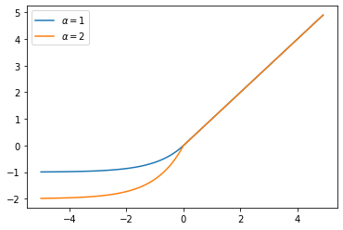
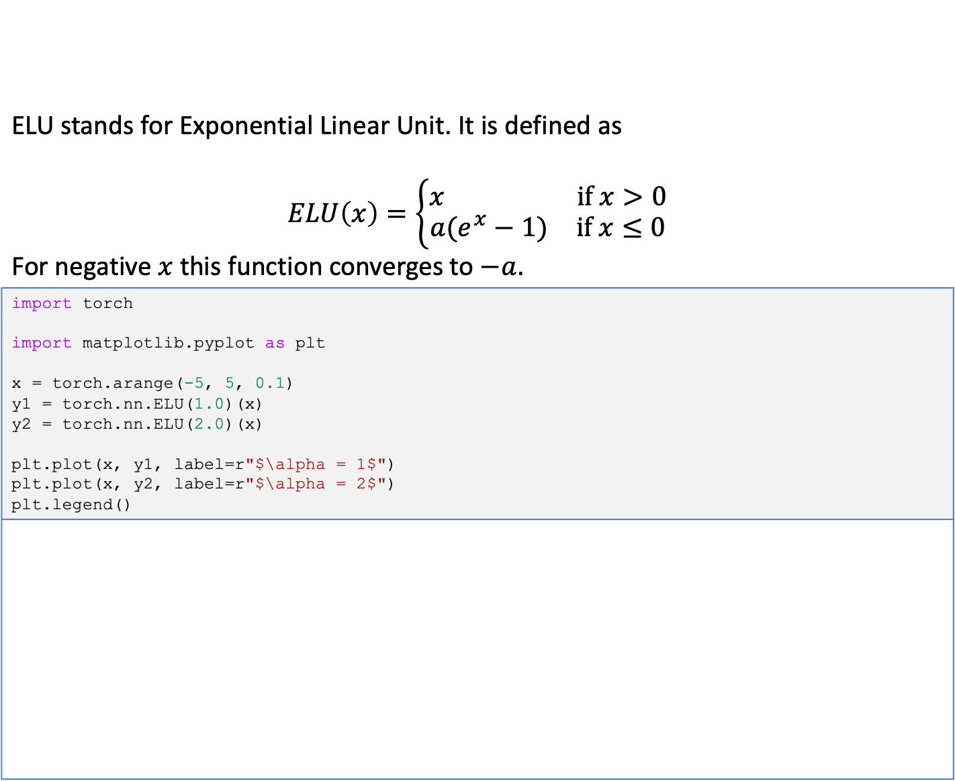
A Surname Classifier with Convolutional Networks
ELU stands for Exponential Linear Unit. It is defined as $$ELU\left(x\right)=\left\{\begin{aligned}\begin{matrix}x & \text{if} x>0\end{matrix} \\ \begin{matrix}a(e^{x}−1) & \text{if} x≤0\end{matrix}\end{aligned}\right.$$ For negative $x$ this function converges to $−a$.
import torch import matplotlib.pyplot as plt x = torch.arange(-5, 5, 0.1) y1 = torch.nn.ELU(1.0)(x) y2 = torch.nn.ELU(2.0)(x) plt.plot(x, y1, label=r"$\alpha = 1$") plt.plot(x, y2, label=r"$\alpha = 2$") plt.legend()

Slide 10
The Training Routine
Train state is meant to keep early stopping parameters, learning rate, training, validation and evaluation losses training, validation and evaluation accuracies
def make_train_state(args): return {'stop_early': False, 'early_stopping_step': 0, 'early_stopping_best_val': 1e8, 'learning_rate': args.learning_rate, 'epoch_index': 0, 'train_loss': [], 'train_acc': [], 'val_loss': [], 'val_acc': [], 'test_loss': -1, 'test_acc': -1, 'model_filename': args.model_state_file}

Slide 11
The Training Routine
Method update_train_state() uses current training state to decide if early stopping is needed. Training should be stopped at the point when performance on a validation dataset starts to degrade. This simple, effective, and widely used approach to training neural networks is called early stopping.
def update_train_state(args, model, train_state): # Save one model at least if train_state['epoch_index'] == 0: torch.save(model.state_dict(), train_state['model_filename']) train_state['stop_early'] = False # Save model if performance improved elif train_state['epoch_index'] >= 1: loss_tm1, loss_t = train_state['val_loss'][-2:] # If loss worsened if loss_t >= train_state['early_stopping_best_val']: # Update step train_state['early_stopping_step'] += 1 # Loss decreased else: # Save the best model torch.save(model.state_dict(), train_state['model_filename']) # Reset early stopping step train_state['early_stopping_step'] = 0 # Stop early ? train_state['stop_early'] = (train_state['early_stopping_step'] >= args.early_stopping_criteria) return train_state

Slide 12
The Training Routine
Arguments of the training routine contains: filenames of dataset, vectorizers and models, model hyper parameters, training parameters.
args = Namespace( # Data and path information surname_csv="surnames_with_splits.csv", vectorizer_file="vectorizer.json", model_state_file="model.pth", save_dir=".", # Model hyper parameters num_channels=256, # Training hyper parameters seed=1337, num_epochs=100, early_stopping_criteria=5, learning_rate=0.001, batch_size=64, # Runtime options cuda=False, reload_from_files=False, expand_filepaths_to_save_dir=True, ) # Check CUDA if not torch.cuda.is_available(): args.cuda = False args.device = torch.device("cuda" if args.cuda else "cpu")

Slide 13
The Training Routine
Initialization of training routine: loads the dataset gets the vectorizer instantiate the model, define the loss function, optimizer and learning rate scheduler create initial train state
dataset = SurnameDataset.load_dataset_and_make_vectorizer(args.surname_csv) vectorizer = dataset.get_vectorizer() classifier = SurnameClassifier(initial_num_channels=len(vectorizer.surname_vocab), num_classes=len(vectorizer.nationality_vocab), num_channels=args.num_channels) classifier = classifier.to(args.device) dataset.class_weights = dataset.class_weights.to(args.device) loss_func = nn.CrossEntropyLoss(dataset.class_weights) optimizer = optim.Adam(classifier.parameters(), lr=args.learning_rate) scheduler = optim.lr_scheduler.ReduceLROnPlateau(optimizer=optimizer, mode='min', factor=0.5, patience=1) train_state = make_train_state(args)

Slide 14
The Training Routine
Setting progress bars for epoch, training and validation.
epoch_bar = tqdm(desc='training routine', total=args.num_epochs, position=0) dataset.set_split('train') train_bar = tqdm(desc='split=train', total=dataset.get_num_batches(args.batch_size), position=1, leave=True) dataset.set_split('val') val_bar = tqdm(desc='split=val', total=dataset.get_num_batches(args.batch_size), position=1, leave=True)

Slide 15
The Training Routine
Train Split zero the gradients compute the output compute the loss (moving average) use loss to produce gradients use optimizer to take gradient step compute the accuracy update the bar
for epoch_index in range(args.num_epochs): train_state['epoch_index'] = epoch_index dataset.set_split('train') batch_generator = generate_batches(dataset, batch_size=args.batch_size, device=args.device) running_loss = 0.0 running_acc = 0.0 classifier.train(True) for batch_index, batch_dict in enumerate(batch_generator): optimizer.zero_grad() # (1) y_pred = classifier(batch_dict['x_surname']) # (2) # (3) loss = loss_func(y_pred, batch_dict['y_nationality']) loss_t = loss.item() running_loss += (loss_t - running_loss) / (batch_index + 1) loss.backward() # (4) optimizer.step() # (5) # (6) acc_t = compute_accuracy(y_pred, batch_dict['y_nationality']) running_acc += (acc_t - running_acc) / (batch_index + 1) # (7) train_bar.set_postfix(loss=running_loss, acc=running_acc, epoch=epoch_index + 1) train_bar.update() train_state['train_loss'].append(running_loss) train_state['train_acc'].append(running_acc)

Slide 16
The Training Routine
Val Split compute the output compute the loss (moving average) compute the accuracy update the train state update the learning rate of the optimizer according to the loss after validation checks for the early stopping update bars
dataset.set_split('val') batch_generator = generate_batches(dataset, batch_size=args.batch_size, device=args.device) running_loss = 0. running_acc = 0. classifier.train(False) # equivalent to classifier.eval() for batch_index, batch_dict in enumerate(batch_generator): y_pred = classifier(batch_dict['x_surname']) # (1) # (2) loss = loss_func(y_pred, batch_dict['y_nationality']) loss_t = loss.to("cpu").item() running_loss += (loss_t - running_loss) / (batch_index + 1) # (3) acc_t = compute_accuracy(y_pred, batch_dict['y_nationality']) running_acc += (acc_t - running_acc) / (batch_index + 1) val_bar.set_postfix(loss=running_loss, acc=running_acc, epoch=epoch_index) val_bar.update() train_state['val_loss'].append(running_loss) train_state['val_acc'].append(running_acc) train_state = update_train_state(args=args, model=classifier, train_state=train_state) # (4) scheduler.step(train_state['val_loss'][-1]) # (5) if train_state['stop_early']: # (6) break # (7) train_bar.n = 0 val_bar.n = 0 epoch_bar.update()

Slide 17
Evaluation
Test Split compute the output compute the loss (moving average) compute the accuracy
# compute the loss & accuracy on the test set using the best available model classifier.load_state_dict(torch.load(train_state['model_filename'])) classifier = classifier.to(args.device) dataset.class_weights = dataset.class_weights.to(args.device) loss_func = nn.CrossEntropyLoss(dataset.class_weights) dataset.set_split('test') batch_generator = generate_batches(dataset, batch_size=args.batch_size, device=args.device) running_loss = 0. running_acc = 0. classifier.eval() for batch_index, batch_dict in enumerate(batch_generator): y_pred = classifier(batch_dict['x_surname']) # (1) # (2) loss = loss_func(y_pred, batch_dict['y_nationality']) loss_t = loss.item() running_loss += (loss_t - running_loss) / (batch_index + 1) # (3) acc_t = compute_accuracy(y_pred, batch_dict['y_nationality']) running_acc += (acc_t - running_acc) / (batch_index + 1) train_state['test_loss'] = running_loss train_state['test_acc'] = running_acc print(f"Test loss: {train_state['test_loss']}") print(f"Test Accuracy: {train_state['test_acc']}")
Test loss: 1.8183988134066262 Test Accuracy: 56.770833333333

Slide 18
Evaluation
Plot confusion matrix
dataset.set_split("test") data = next(generate_batches(dataset, len(dataset))) x_data, y_truth = data["x_surname"], data["y_nationality"] y_pred = classifier(x_data, apply_softmax=True).argmax(dim=1) labels = list(vectorizer.nationality_vocab._token_to_idx) conf_df = pd.DataFrame(confusion_matrix(y_truth, y_pred), index=labels, columns=labels) sns.heatmap(conf_df, annot=True, cbar=None, cmap="YlGnBu", fmt="d") plt.tight_layout() plt.ylabel("True Class"), plt.xlabel("Predicted Class") plt.show()

Slide 19
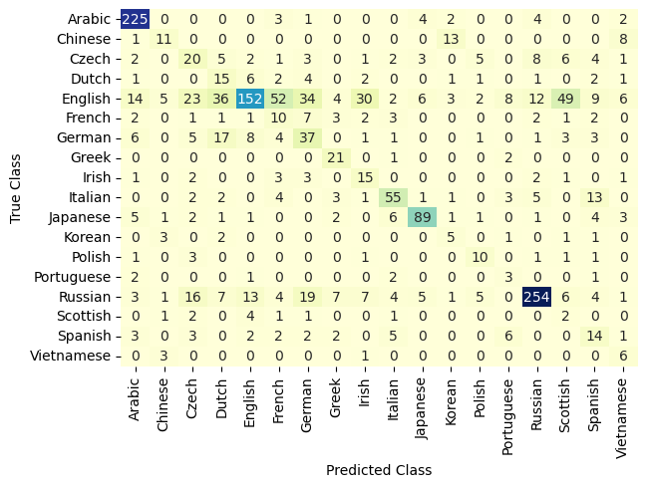
Evaluation

Slide 20
Inference
Another method for evaluating the model is to do inference on new data and make qualitative judgments about whether the model is working. Given a surname as a string, the function will first apply the vectorization process and then get the model prediction. Notice that we include the apply_softmax flag so that result contains probabilities. The model prediction, in the multinomial case, is the list of class probabilities. PyTorch tensor max() function gets the best class, represented by the highest predicted probability.
def predict_nationality(surname, classifier, vectorizer): vectorized_surname = vectorizer.vectorize(surname) vectorized_surname = torch.tensor(vectorized_surname).unsqueeze(0) result = classifier(vectorized_surname, apply_softmax=True) probability_values, indices = result.max(dim=1) index = indices.item() predicted_nationality = vectorizer.nationality_vocab.lookup_index(index) probability_value = probability_values.item() return {'nationality': predicted_nationality, 'probability': probability_value}

Slide 21
Inspection
It is often useful to look at more than just the best prediction. For example, it is standard practice in NLP to take the top k best predictions and rerank them using another model. PyTorch provides a torch.topk() function that offers provides a convenient way to get these predictions.
def predict_topk_nationality(name, classifier, vectorizer, k=5): vectorized_name = vectorizer.vectorize(name) vectorized_name = torch.tensor(vectorized_name).unsqueeze(0) prediction_vector = classifier(vectorized_name, apply_softmax=True) probability_values, indices = torch.topk(prediction_vector, k=k) # returned size is 1,k probability_values = probability_values.detach().numpy()[0] indices = indices.detach().numpy()[0] results = [] for prob_value, index in zip(probability_values, indices): nationality = vectorizer.nationality_vocab.lookup_index(index) results.append({'nationality': nationality, 'probability': prob_value}) return results def run_topk_predictions(surname, k=5): if k > len(vectorizer.nationality_vocab): print("Sorry! That's more than the # of nationalities we have.. / defaulting you to max size :)") k = len(vectorizer.nationality_vocab) predictions = predict_topk_nationality(surname, classifier, vectorizer, k=k) print(f"Top {k} predictions:") print("===================") for prediction in predictions: print(f"{surname} -> {prediction['nationality']} / (p={prediction['probability']:0.2f})")

